Slide 1
CONTINUOUS INTEGRATION
06-Jan-2017

Slide 2
Change LOG
Author | Changes | Date
Ajai Bharadwaj | Initial draft with Agenda | 15/12/2016
Srikanth Prathipati | Updated the Slides with CI/CD best practices | 06/01/2017
Notes:
The needs of IT are evolving and now IT has to operate in a hybrid cloud environment while becoming a bi-modal organization itself
Integration plays a vital role in both traditional and new IT models:
webMethods Integration platform provides hybrid integration and API management capabilities to enable IT to meet modern challenges
Any application whether it is an on-premise legacy app or a newly acquired cloud app can be seamlessly integrated into IT landscape
New applications can be built quickly using the existing applications and be exposed via mobile and smart devices
Data and logic residing in IT apps can be exposed via APIs to customers and 3rd party app developers to open new revenue channels
New apps and rich context powered by integrated apps can be used to improve customer experience
External partners, such as suppliers, can be digitally integrated for improved security and performance into B2B transactions
Wide range of IT, B2B and API standards are supported to quickly integrate new IT investments into IT fabric
Enterprise file transfers that scale as needed improve security and responsiveness of the company itself
MDM is the “spell check” for the systems, ensuring data is accurate. It reduces costly data errors and improves customer experience

Slide 3
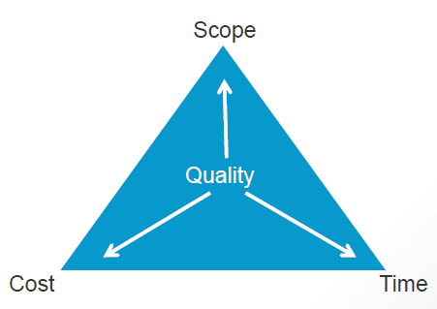
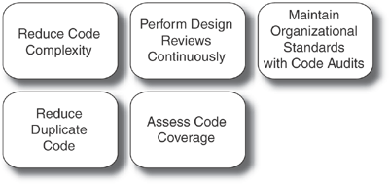
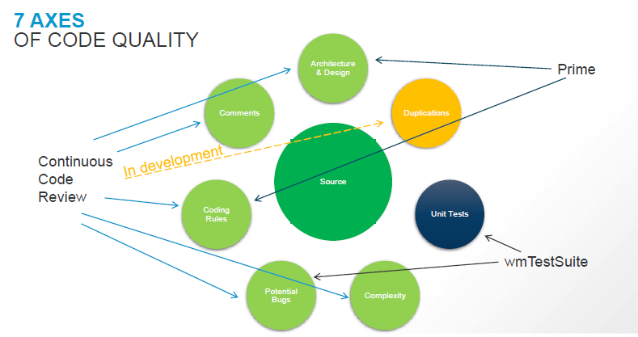
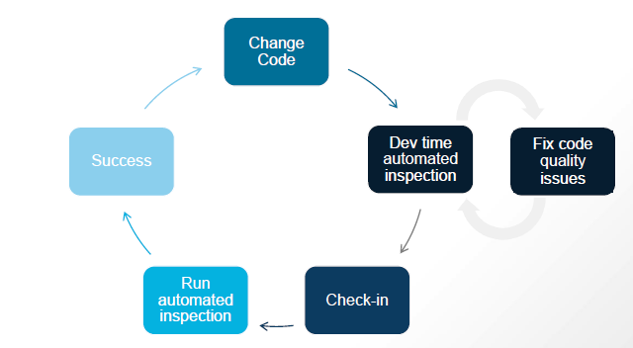
Continous INSPECTION

Slide 4
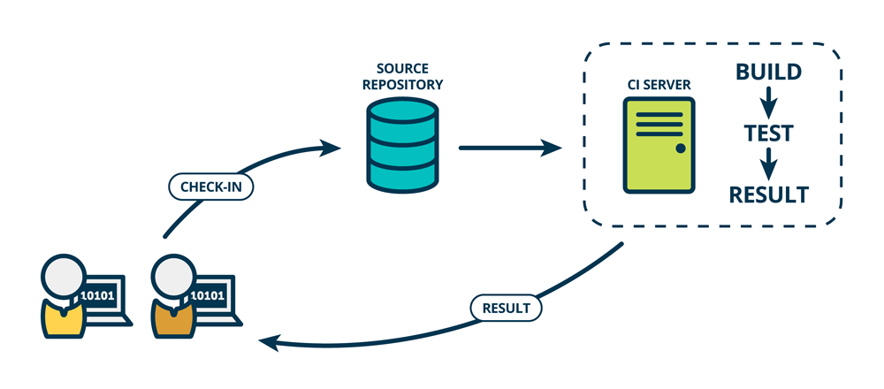
Continous Integration

Slide 5
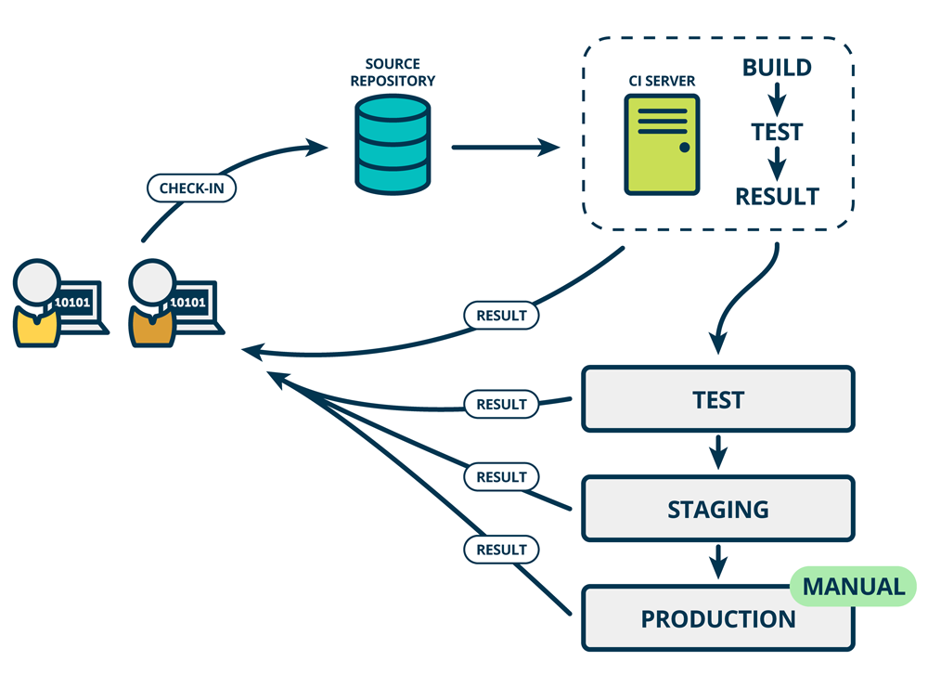
Continous Delivery

Slide 6
How Does it work
DEVELOP
BUILD
DEPLOY
TEST
NOTIFY
DEVELOPMENT
ENVIRONMENT
Jenkins
Report
SAG Designer
WmTestSuite
ASSET BUILD
ENVIRONMENT
DEPLOYMENT
ENVIRONMENT
TESTING
HARNESS
Developer checks in changes
Jenkins checks out changes
Jenkins calls Asset Build script
Jenkins calls ProjectAutomator script
Jenkins calls wM Deployer command line scripts to push build to Reference Server
Jenkins calls Ant scripts to execute WmTestSuite
If build fails → Jenkins mails Build Manager
If build passes → Build Manager tags build in GIT
Build Manager deploys build to the next stage from the Jenkins job (here: TEST ENV).
SoapUI
ABE
wM Deployer
WmTestSuite
LOCAL SERVERS
ANT
ProjectAutomator
Citrus | SoapUI
MWS¹
Selenium & others
wM IS²
Check out
Create
Composites
Deploy Composites
wM UM³
TEST ENVIRONMENT
Check in
SHARED SEVERS
MWS
GIT
REFERENCE
SERVER
wM IS
wM UM
file-based repository
1) My webMethods Server 2) Integration Server 3) Universal Messaging 4) Version Control System

Slide 7
DEVELOP
REVIEW & BUILD
DEPLOY
TEST
NOTIFY
DEVELOPMENT
ENVIRONMENT
Jenkins
Report
SAG Designer
ISCCR
BUILD
ENVIRONMENT
DEPLOYMENT
ENVIRONMENT
TESTING
HARNESS
WmTestSuite
SoapUI
ISCCR
wM Deployer
WmTestSuite
LOCAL SERVERS
ABE
ProjectAutomator
Citrus | SoapUI
MWS
ANT
Selenium & others
wM IS
Check out
Create
Composites
Deploy Composites
wM UM
TEST ENVIRONMENT
Check in
SHARED SEVERS
MWS
VCS
REFERENCE
SERVER
wM IS
wM UM
file-based repository

Slide 8
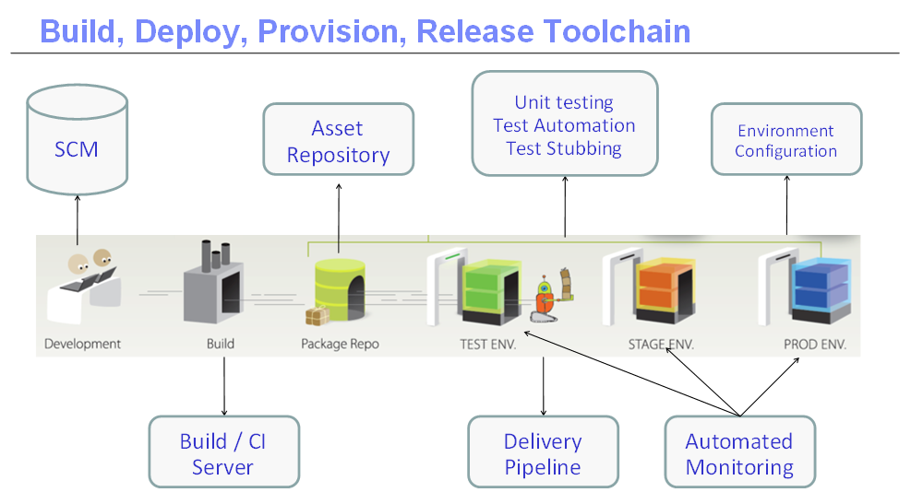
Continous Delivery – Maturity at its best

Slide 9
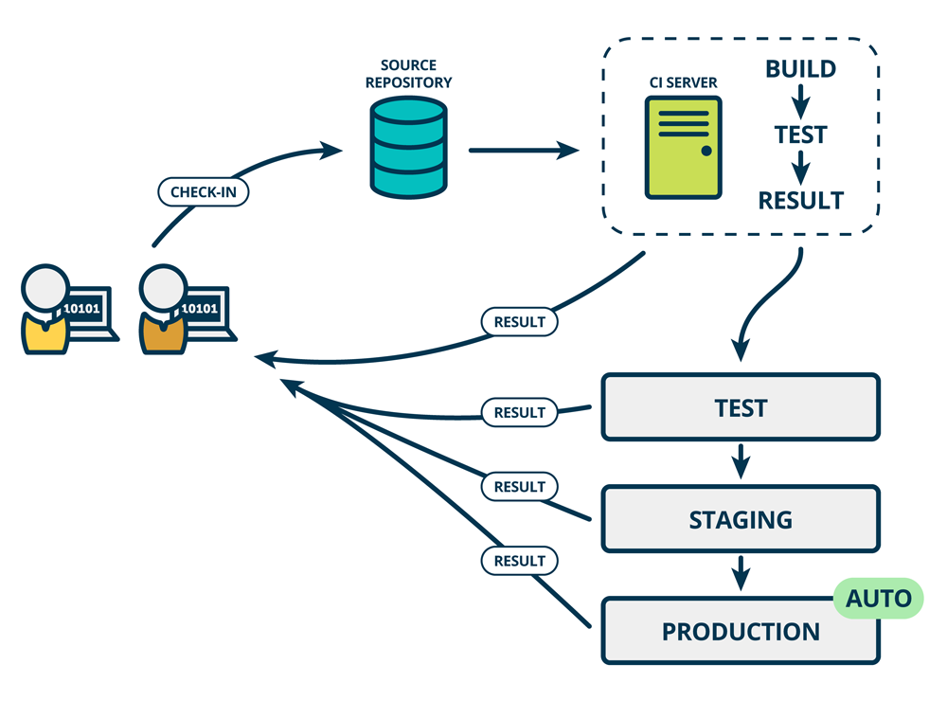
Continous Deployment

Slide 10
Topic
Continuous integration- maturity levels
Maturity Level | Comments
Level 0 | No version control
Level 1 | Packages versioned with version control system
Level 2 | Level 1 + ABE for builds, build server
Level 3 | Level 2 + automated code reviews & unit testing, reference server
Level 4 | Level 3 + automated regression testing
Level 5 | Level 4 + nightly builds + automated deployments to SIT
Level 6 | Level 5 + automated integration testing & performance testing,
Level 7 | Level 6 + automated hot deployments / queisce mode, containers for deployments
Continuous Integration
Continuous Delivery

Slide 11
Topic
Continuous integration- updates
The responses were collated based on which the CI maturity level was set for each project
Project Name | Maturity Level | Comments
SCB-EDMi Platform | 4.5 | Automated deployments to higher environments missing, but quiesce mode used
NIC DBP | 5
J&J CAPRI | 2.5 | Automated code review and unit testing missing
Accounts Payable | 2.5 | Automated code review and unit testing missing
Google | 2.5 | Automated code review and unit testing missing
Akzo | 2.5 | Automated code review and unit testing missing, but regression test automation done
J&J RnD Link | 2 | Need further info
J&J FRED | 1
Sainsbury's | 1 | CI was being implemented earlier
HQ | 1
J&J Elements | 1
J&J Concerto | 1
HQ-GS3 | 0.5 | version control being used
Solution Book | 0

Slide 12
Topic
Continuous integration- next steps
Next steps would be to get all the projects to maturity level 4 by 31-March-2017
Packages versioned with version control system
ABE for builds, build server
automated code reviews & unit testing, reference server
automated regression testing
This needs a strong, committed and concerted effort to achieve this for ALL the projects by 31-March-2017
The CI core team would work with the PMs/Tech leads for each project in the list that is not at maturity level 4 to come out with a plan to achieve level 4
Setup meetings with PM & Tech leads to understand the challenges and steps that will be required to achieve this
Audit the projects on fortnightly basis from January 2017 to track the progress

Slide 13
